Slide 1

DEPARTMENT OF COMPUTER ENGINEERING, MODELING, ELECTRONICS AND SYSTEM ENGINEERIN LM-Telecommunication Engineering: Smart Sensing, Computing and Networking Network Security
Project Title: Project: Detection and Mitigation of DHCP Starvation Attacks Using Entropy-Based Analysis
Implemented by: Rami Saleh

Slide 2
Motivation & Problem
DHCP is critical for dynamic IP assignment in networks.
It is vulnerable to DHCP starvation attacks that exhaust the IP pool.
Goal: Design a lightweight detection and mitigation system using entropy analysis of DHCP Discover packets.

Slide 3
DHCP Protocol
DHCP (Dynamic Host Configuration Protocol) assigns IP addresses dynamically.
uses a four-step message exchange process, commonly referred to as DORA: Discover, Offer, Request, ACK.
Vulnerable due to unauthenticated broadcast Discover messages.

Slide 4
DHCP Starvation Attack
is a type of Denial-of-Service (DoS) attack targeting the Dynamic Host Configuration Protocol (DHCP) server
Attacker floods the network with spoofed DHCP Discover packets
Exhausts server IP pool → denial of service for legitimate clients, Because each Discover message appears to come from a different client, the server allocates a new IP address for each one, eventually running out of addresses to assign.
Typically uses tools like Yersinia.

Slide 5
Defense Mechanisms
DHCP Snooping: filters traffic from untrusted ports
Port Security: limits the number of MAC addresses allowed on a single port.
Rate Limiting: sets a maximum threshold of DHCP requests per second.
This work: Behavioral detection via entropy + active mitigation.

Slide 6
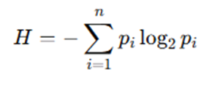
Entropy
Shannon entropy quantifies randomness or unpredictability.
is used to detect anomalies. A sudden drop or increase in entropy may indicate unusual patterns—such as automated attacks, spoofing, or flooding—compared to the baseline of normal behavior.
High entropy in MAC addresses or packet timing may indicate diverse, random, or bursty behavior (normal traffic).
Low entropy may suggest repetitive or forged traffic, such as identical MAC addresses or fixed inter-arrival times (suspicious patterns)
Applied to MAC addresses (H_MAC) and inter-arrival times (H_IAT).

Slide 7
Detection Mechanism (Method)
The detection mechanism is implemented in Python using the Scapy library to analyze .pcap files :
Reads .pcap files captured via tcpdump
Extracts only DHCP Discover packets (MAC & timestamp)
Processes packets in fixed-size windows (e.g., 20 packets)
Inter-arrival times (IATs) are binned into discrete intervals using a bin size of 1 millisecond (0.001 sec) to stabilize entropy estimation. (the bin size determines how finely the IAT values are grouped before entropy calculation)
Calculates:
H_MAC: Entropy of MAC addresses
H_IAT: Entropy of Inter-Arrival Times
Combines into H_total to decide anomaly
Detection decision:
If H_total < θ → Anomaly Detected (θ = 0.6)
Triggers mitigation

Slide 8
Detection Mechanism (Method)
Mitigation:
Enforces a lease rate limit R = 5 per second
Blocks excessive DHCP Discover traffic
Performance metrics are computed after analysis:
True Positives (TP): Number of attack windows correctly identified.
False Negatives (FN): Number of attack windows missed.
Accuracy: Percentage of correct classifications (TP / total).
Precision: How many detected anomalies were actually attacks.
Recall: How many actual attacks were correctly detected.
F1-score: Harmonic mean of precision and recall.
Also tracks detection delay which is measured as the time elapsed between the first DHCP Discover packet and the last packet in the first anomalous window. It is calculated as
(Detection Time = ‘timestamp of detection’ − ‘attack start time’)

Slide 9
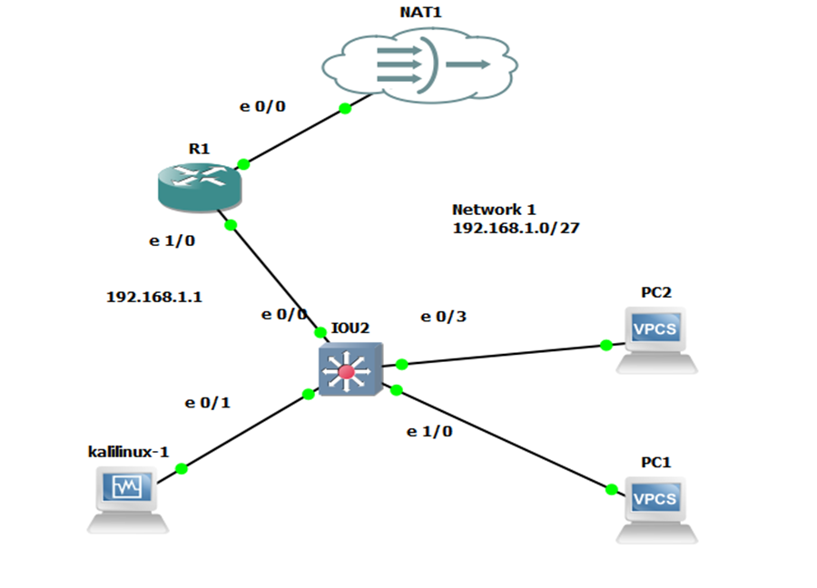
GNS3 Testbed Topology
Includes Kali Linux (attack/benign traffic), PCs, and DHCP server.
Traffic captured with tcpdump.
Traces analyzed offline.
Two scenarios:
Attack trace using Yersinia.
Benign trace using Python script.

Slide 10
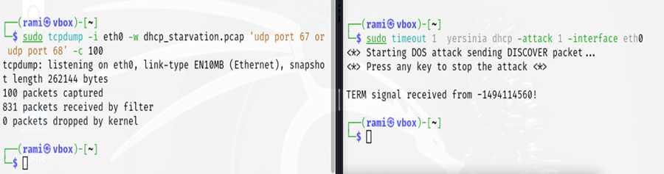
Small Attack Scenario (A1)
100 packets captured , Window size = 20
The result :
Detection:
H_MAC = 1.0, H_IAT = 0.0 → H_total = 0.3 < θ
All 5 windows flagged as anomalous
Metrics:
True Positives (TP): 5
False Negatives (FN): 0
Accuracy: 100.00%
Precision: 100.00%
Recall: 100.00%
F1-Score: 100.00%
Detection time: ~0.0003 sec
Immediate Mitigation Triggered: DHCP requests blocked for 2 seconds after anomaly.
Detection Time: 0.000319 seconds after attack started.
Total analysis time: 0.0646 seconds

Slide 11
Medium & Large Attack Results (A2 & A3)
Results:
Even under high traffic, system detects all attacks instantly.
Mitigation activates after first window.
Case | Packets | W | TP | FN | Accuracy | F1-Score | Detection Time | Analysis Time
A2 | 1000 | 50 | 20 | 0 | 100% | 100% | 0.0038 s | 0.599 s
A3 | 10000 | 100 | 100 | 0 | 100% | 100% | 0.0022 s | 6.657 s

Slide 12
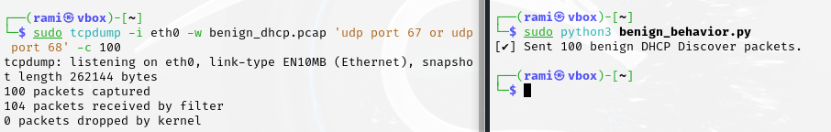
Small Benign Scenario (B1)
100 packets, W = 20
The result :
MAC Entropy = 0.0 (same client)
IAT Entropy = 1.0 (variable delay)
H_total = 0.7 > θ → Normal
No anomaly detected , no mitigation needed, no false positives (metrics not applicable for benign trace)
Total analysis time: 0.0634 seconds

Slide 13
Medium & Large Benign Results (B2 & B3)
Results:
All benign traces correctly classified.
Confirms no false alarms.
Case | Packets | W | Anomaly | Accuracy | F1-Score | Analysis Time
B2 | 1000 | 50 | No | 100% | N/A | 0.606 s
B3 | 10000 | 100 | No | 100% | N/A | 6.362 s

Slide 14
Evaluation of θ and W Parameters
evaluate how the detection system performs across different:
Entropy thresholds θ (used to flag anomalies)
Sliding window sizes W (number of packets per evaluation chunk)
Behavior types: attack vs. benign.
Goal: Study sensitivity of detection.
Lower W = faster detection ; Higher W = smoother trends.
θ between 0.4–0.6 → good tradeoff (no FP, good TP)

Slide 15
Evaluation of θ and W Parameters
1- The results in Attack Behavior
The system detects all attack windows regardless of θ or W → 100% accuracy and zero delay.
Larger window sizes result in fewer detections (e.g., 3 vs. 10) because a larger window aggregates more packets into a single decision unit.
All thresholds work well here
W θ TP FN Acc Prec Recall F1 Detect ? Delay(s) Blocked 10 0.4 10 0 1.00 1.00 1.00 1.00 ✅ 0.00 100 10 0.5 10 0 1.00 1.00 1.00 1.00 ✅ 0.00 100 10 0.6 10 0 1.00 1.00 1.00 1.00 ✅ 0.00 100 10 0.7 10 0 1.00 1.00 1.00 1.00 ✅ 0.00 100 20 0.4 5 0 1.00 1.00 1.00 1.00 ✅ 0.00 100 20 0.5 5 0 1.00 1.00 1.00 1.00 ✅ 0.00 100 20 0.6 5 0 1.00 1.00 1.00 1.00 ✅ 0.00 100 20 0.7 5 0 1.00 1.00 1.00 1.00 ✅ 0.00 10 30 0.4 3 0 1.00 1.00 1.00 1.00 ✅ 0.00 90 30 0.5 3 0 1.00 1.00 1.00 1.00 ✅ 0.00 90 30 0.6 3 0 1.00 1.00 1.00 1.00 ✅ 0.00 90 30 0.7 3 0 1.00 1.00 1.00 1.00 ✅ 0.00 90

Slide 16
Evaluation of θ and W Parameters
2- The results in benign behavior
θ = 0.7 causes false positive behavior (benign misclassified as attack).
θ ≤ 0.6 shows clean separation (no false positives).
Higher thresholds reduce specificity → risk of triggering mitigation on benign clients.
Delay increases with window size, though the effect is minimal due to the benign packet spread.
W θ TP FN Acc Prec Recall F1 Detect ? Delay(s) Blocked 10 0.4 0 0 N/A N/A N/A N/A ❌ N/A 0 10 0.5 0 0 N/A N/A N/A N/A ❌ N/A 0 10 0.6 0 0 N/A N/A N/A N/A ❌ N/A 0 10 0.7 0 0 N/A N/A N/A N/A ✅ 3.63 1 20 0.4 0 0 N/A N/A N/A N/A ❌ N/A 0 20 0.5 0 0 N/A N/A N/A N/A ❌ N/A 0 20 0.6 0 0 N/A N/A N/A N/A ❌ N/A 0 20 0.7 0 0 N/A N/A N/A N/A ✅ 3.63 1 30 0.4 0 0 N/A N/A N/A N/A ❌ N/A 0 30 0.5 0 0 N/A N/A N/A N/A ❌ N/A 0 30 0.6 0 0 N/A N/A N/A N/A ❌ N/A 0 30 0.7 0 0 N/A N/A N/A N/A ✅ 5.43 1

Slide 17
Evaluation of θ and W Parameters
Result for both traces:
All settings detect attacks correctly.
θ > 0.6 risks False Positive (FP) in benign traces.
Chosen: θ = 0.6 , W = 20 but multiple combinations are viable

Slide 18
Visualization of Lease Rates with Mitigation Threshold
visualize the number of DHCP Discover packets (100 packets) over time, comparing the measured rates to the defined mitigation threshold R=5 packets per second
plot two cases:
1.A benign (normal) traffic trace
2. an attack (DHCP starvation) traffic trace

Slide 19
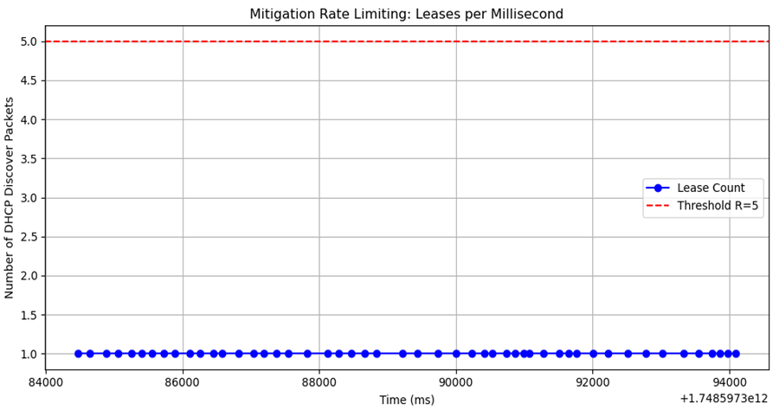
Visualization of Lease Rates with Mitigation Threshold
In the benign trace, the DHCP Discover packet rate per millisecond remains consistently low throughout the observed interval.
For example, in the time window between 88,000 ms and 90,000 ms (88 to 90 seconds), the figure displays approximately 8 points, each representing a single lease event.
This corresponds to a total of 8 leases distributed across 2 seconds, yielding an average lease rate of 4 leases per second, which is below the mitigation threshold of R = 5 leases/sec.
Even if lease spikes above R, no anomaly means no mitigation.

Slide 20
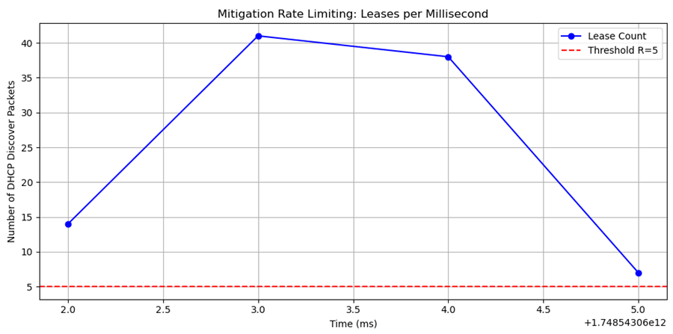
Visualization of Lease Rates with Mitigation Threshold
In the attack trace, the figure clearly demonstrates a burst pattern in DHCP Discover packet activity over time. For example, between 3,000 ms and 5,000 ms, the number of leases issued per millisecond spikes sharply, reaching up to 40 leases in a single millisecond interval.
This level of activity dramatically exceeds the mitigation threshold of R = 5 leases per second, represented by the red dashed line (Blue line exceeds red threshold (R = 5)).
So, Mitigation will active immediately after detection.

Slide 21
Comparison of Bin Size Impact on Detection
the bin size determines how finely the IAT values are grouped before entropy calculation. Too fine or too coarse binning can affect how much useful variation is captured in the entropy measure.
Tested: 0.00001, 0.0001, 0.001, 0.01

Slide 22
Comparison of Bin Size Impact on Detection
Metrics for different bin sizes (Attack case)
With 0.00001, the IAT entropy remained high (≥0.7–0.9), meaning the system interpreted the packet timing as highly diverse, leading to no anomalies detected.
With 0.0001, the IAT entropy dropped in some windows (to 0), correctly flagging anomalies, but one window remained on the edge, causing one false negative.
With 0.001, all windows consistently showed zero IAT entropy (indicating uniform timing, typical in attacks) and were correctly detected as anomalies.
With 0.01, the results were also perfect—but too coarse a bin risks lumping normal variation into broad categories, which might fail under different traffic patterns.
Bin Size | TP | FN | Accuracy | Precision | Recall | F1-Score | Notes
0.00001 | 0 | 5 | 0% | 0% | 0% | 0% | Too fine; entropy too high, no anomaly detected
0.0001 | 4 | 1 | 80% | 100% | 80% | 88.9% | Caught most anomalies, missed one
0.001 | 5 | 0 | 100% | 100% | 100% | 100% | Best performance; all attack windows detected
0.01 | 5 | 0 | 100% | 100% | 100% | 100% | Also perfect, but risks over smoothing

Slide 23
Comparison of Bin Size Impact on Detection
Metrics for different bin sizes (benign case)
Across all bin sizes, the benign trace consistently showed high IAT entropy and was never misclassified as an anomaly. This indicates that our system’s sensitivity with bin size 0.001 is well-calibrated—not overreacting to normal variations
Bin Size | TP | FN | Accuracy | Precision | Recall | F1-Score | Notes
0.00001 | 0 | 2 | 0% | 0% | 0% | 0% | Correctly identified as normal (no anomalies)
0.0001 | 0 | 2 | 0% | 0% | 0% | 0% | Correctly identified as normal
0.001 | 0 | 2 | 0% | 0% | 0% | 0% | Correctly identified as normal
0.01 | 0 | 2 | 0% | 0% | 0% | 0% | Correctly identified as normal

Slide 24
Comparison of Bin Size Impact on Detection
So, bin size 0.001 is validated as the best choice, effectively balancing:
✔ Attack detection power
✔ Robustness against false positives
✔ Computational stability

Slide 25
Conclusion & Advantages of Approach
Successfully implemented entropy-based DHCP starvation detection.
Lightweight and fast (analyzes 10K packets in < 7 seconds ).
No dependency on deep packet inspection
Zero false positives in all tests.
Accurate, scalable, and interpretable.
Ready for real-time deployment with adaptive mitigation.

Slide 26
Limitations and Future Work
Current method limited to offline .pcap traces
Can be extended to live interface monitoring
Integrate with firewall rules or switch controls
Adaptive θ selection via machine learning

Slide 27
Thank you very much

